Slide 1
“Alwan” Modern Printing Press
Team members
Sameh Ahmed Ahmed Mohmed Saad Fady Hanna
Mahmoud Abdella Youssef Mohamed

Slide 2

Introduction
“ Alwan” Printing Press is a medium-sized project launched on January 1, 2024.
Built on 1,600 M² with dedicated production and administration areas.
Equipped with modern printing systems to ensure high efficiency and meet diverse customer needs with top quality.

Slide 3
Gap Analysis
Met with each department manager to understand their work and identify common challenges.
Discussed expectations for the new system (Odoo V18 ERP) to improve efficiency and ease of work.

Slide 4
FIRST: Warehouse Management
Manual item placement leads to misplacement and stock inaccuracies.
Proposed solution: activate putaway rules in Odoo to automatically direct received items to their designated storage locations.

Slide 5

SECOND : Paper Stock Summary
Accurate recording of paper stocks is critical for operations.
Paper is purchased by weight for better pricing and availability.
Issuing is done in packages, not by weight.
Unit conversion may cause human errors affecting stock accuracy.

Slide 6
Third: Internal Transfer Visibility
The client requested to display internal transfers between warehouses, along with the related transfer documents.

Slide 7
Fourth: Scrap Warehouse Permission
No clear rules on who can approve scrap warehouse actions
Mistakes or misuse can happen by accident
This causes problems with tracking scrap and recycling it .

Slide 8

Fifth: Fixed Assets Management
Purchase of assets (computers, printers, POS devices).
Temporary storage in warehouses to ensure continuous operations.
Automated workflow to manage issuing and reduce human errors.
Depreciation starts only after the asset is issued and used.

Slide 9
Accounting: Chart of Accounts
The Chart of Accounts was built based on client requirements. Main account groups were created for structure only, while active sub-accounts are used for transactions in Odoo.

Slide 10
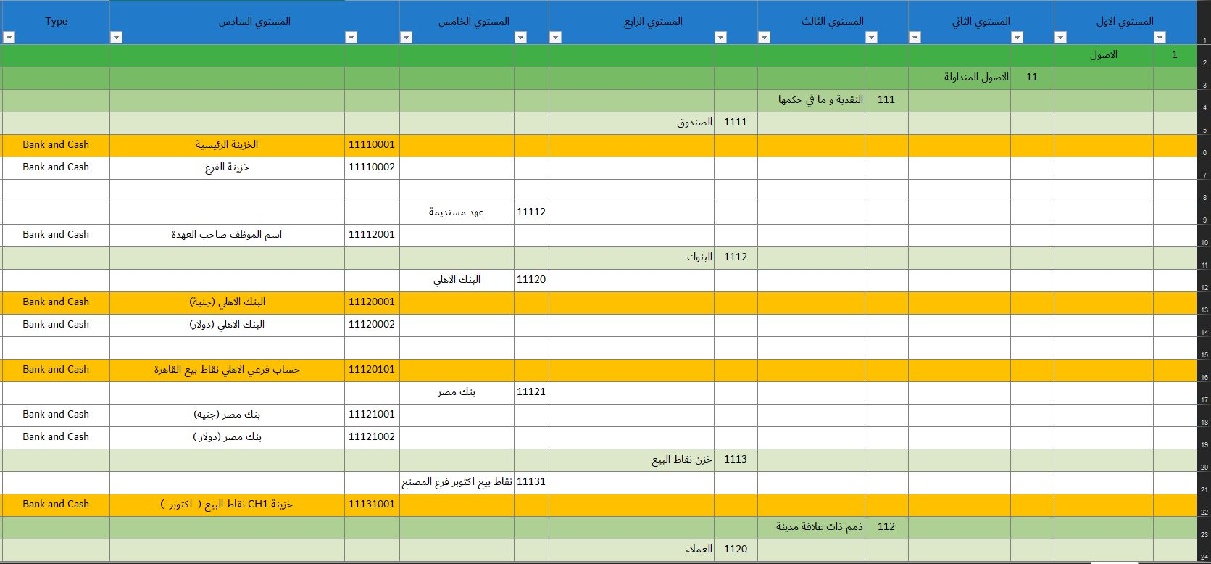
1- Chart of Account Levels :

Slide 11
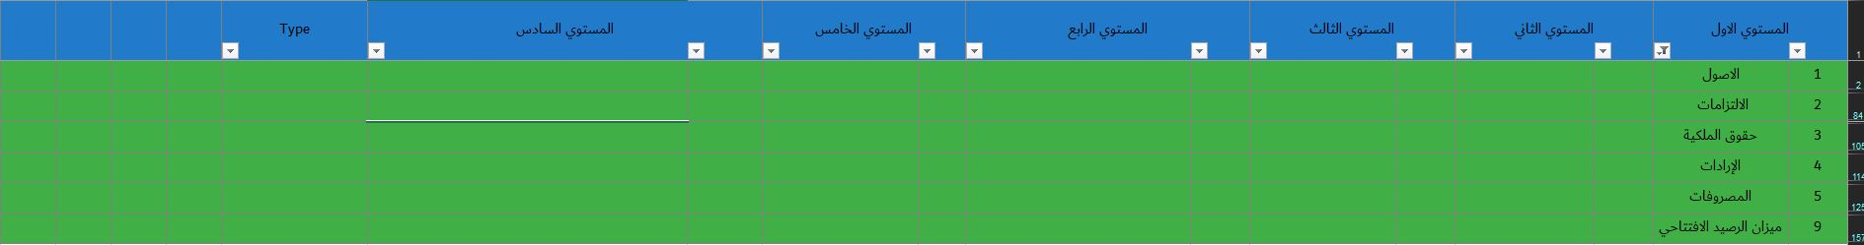
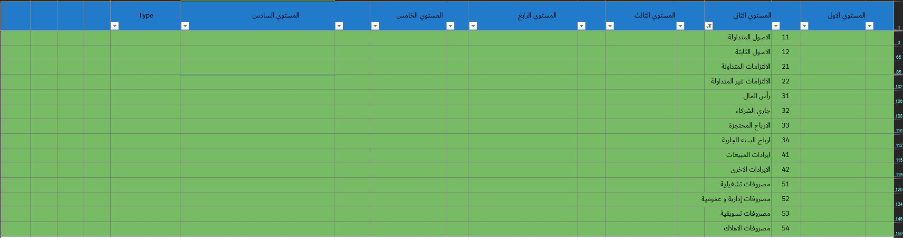

Slide 12
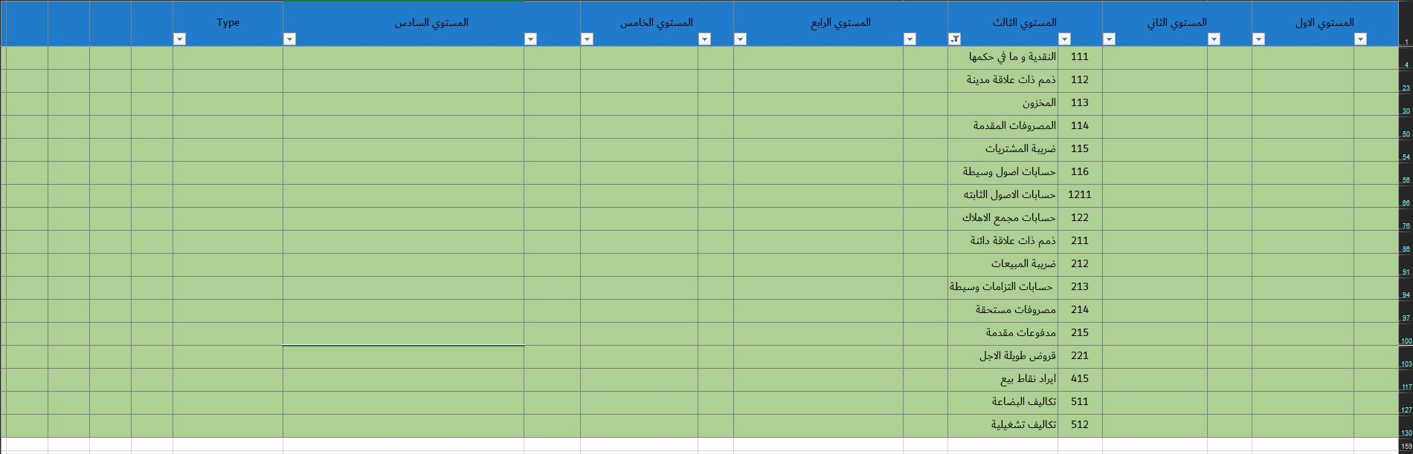
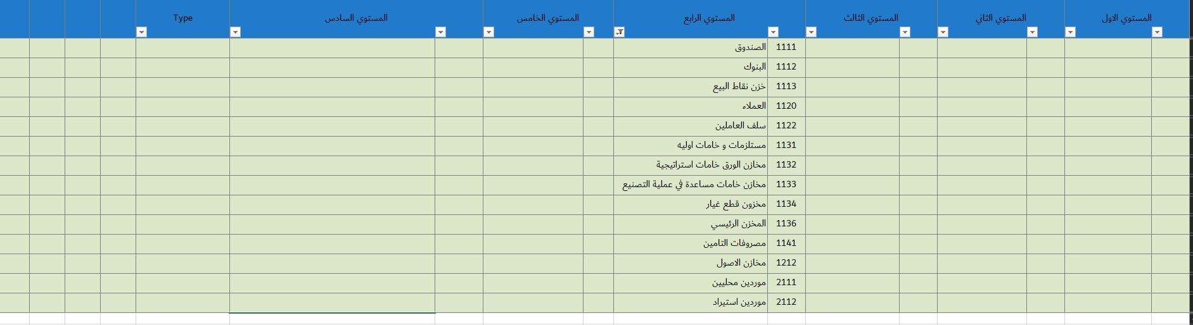

Slide 13
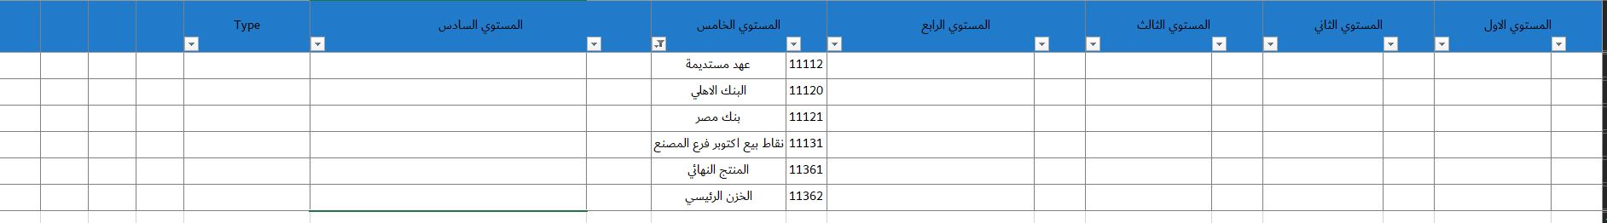
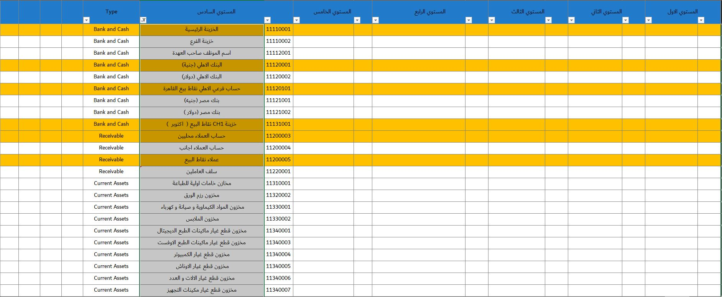

Slide 14
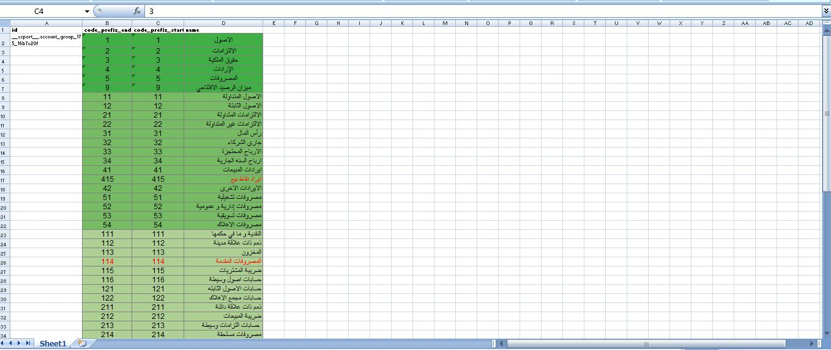
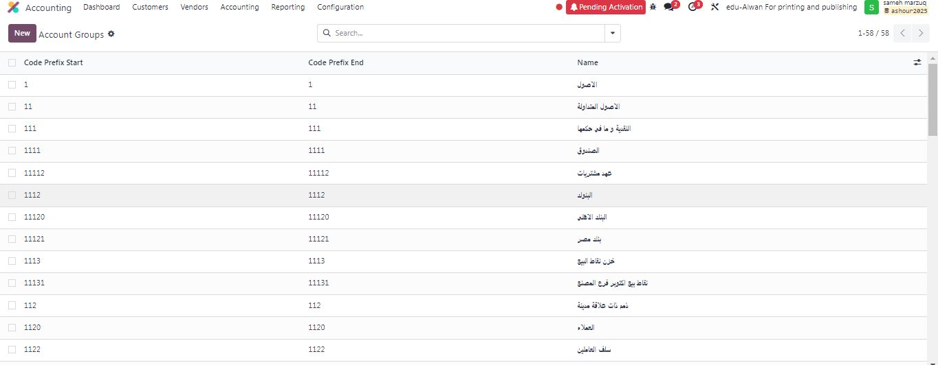
2- Account Groups :

Slide 15
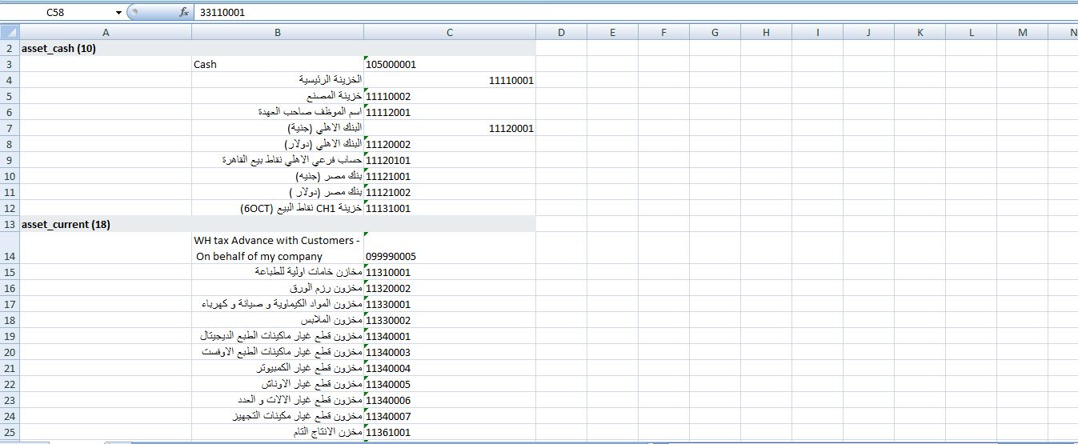
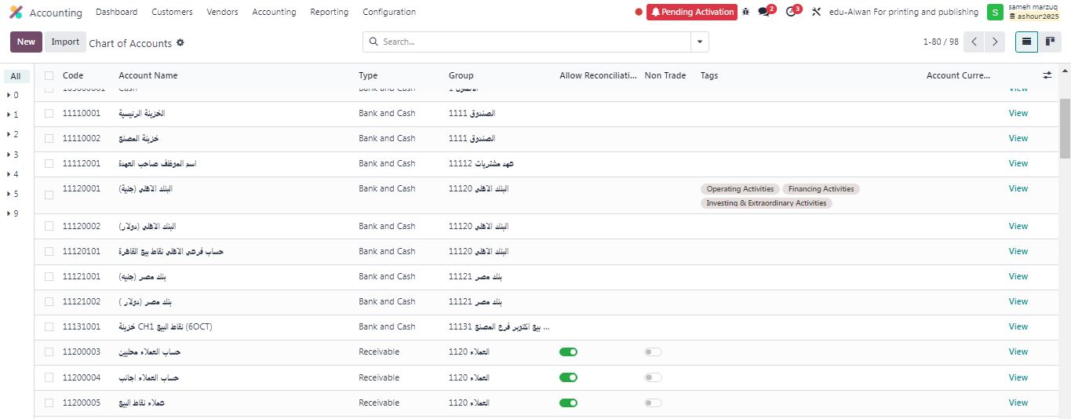
3- Chart of Accounts :

Slide 16
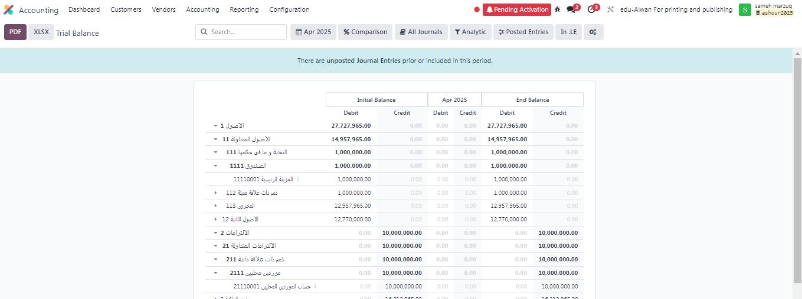
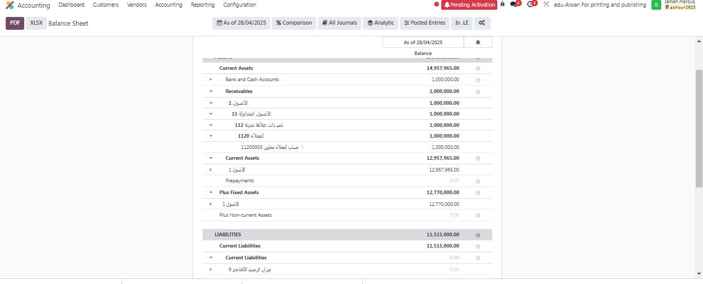
4- Tree Structure Display The hierarchical structure was applied in both the Trial Balance and the Budget reports for clearer financial tracking

Slide 17
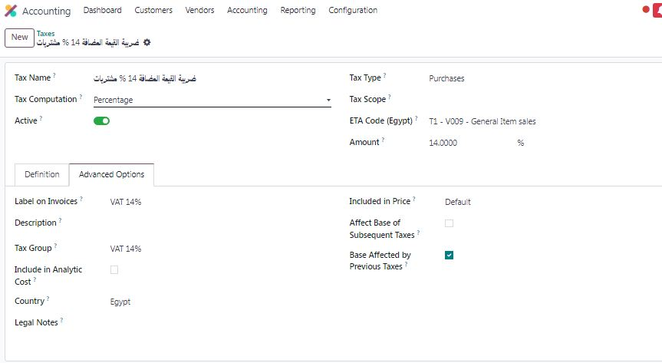
5- Taxes Settings

Slide 18
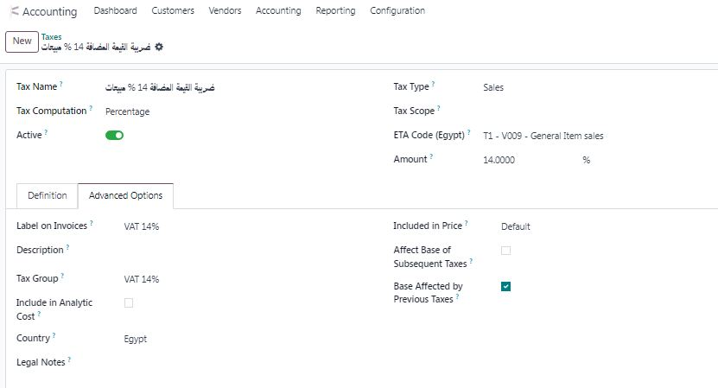
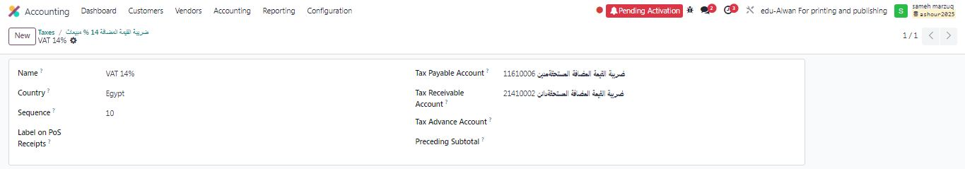

Slide 19
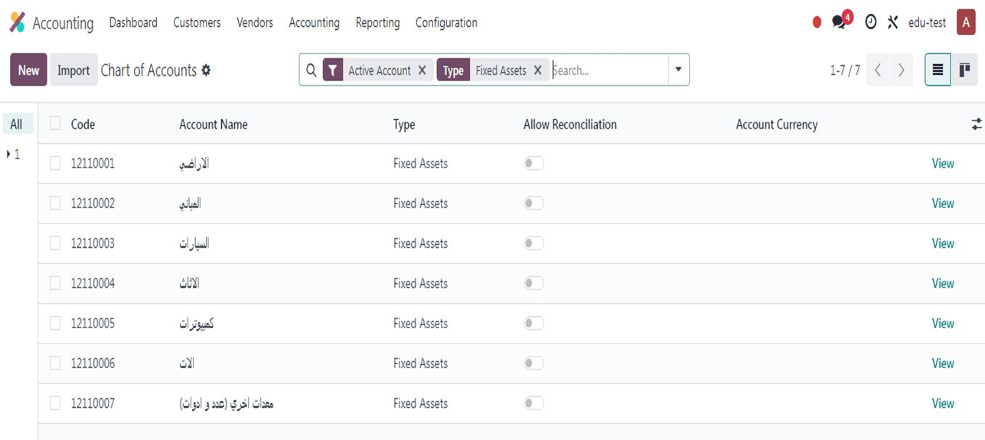
Accounting: Asset Creation
1- A group of asset accounts was created in the printing press chart of accounts (Fixed Assets), including 7 accounts:

Slide 20
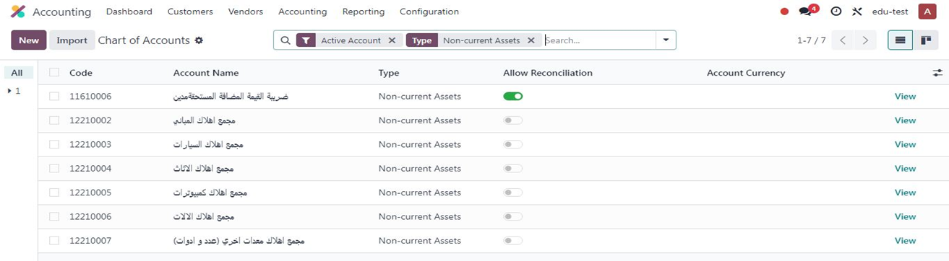
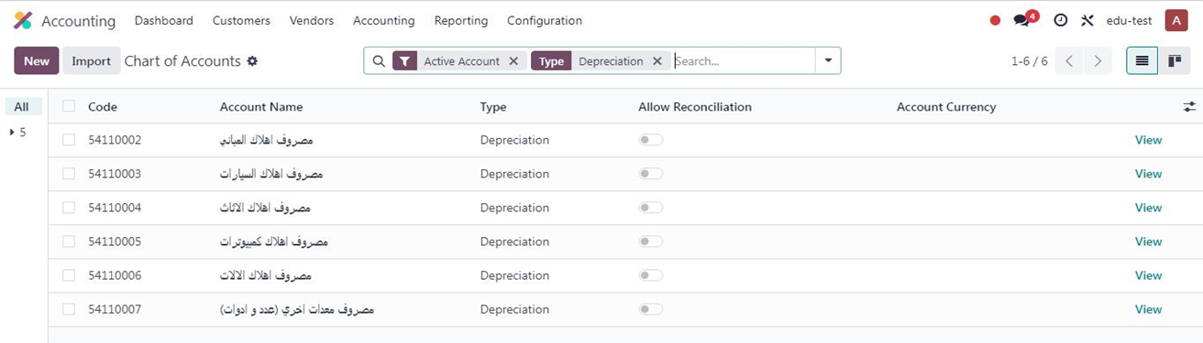
2- A group of accumulated depreciation accounts was created in the chart of accounts, including 6 accounts:
3- A group of depreciation expense accounts was created for the current accounting period, including 6 accounts:

Slide 21
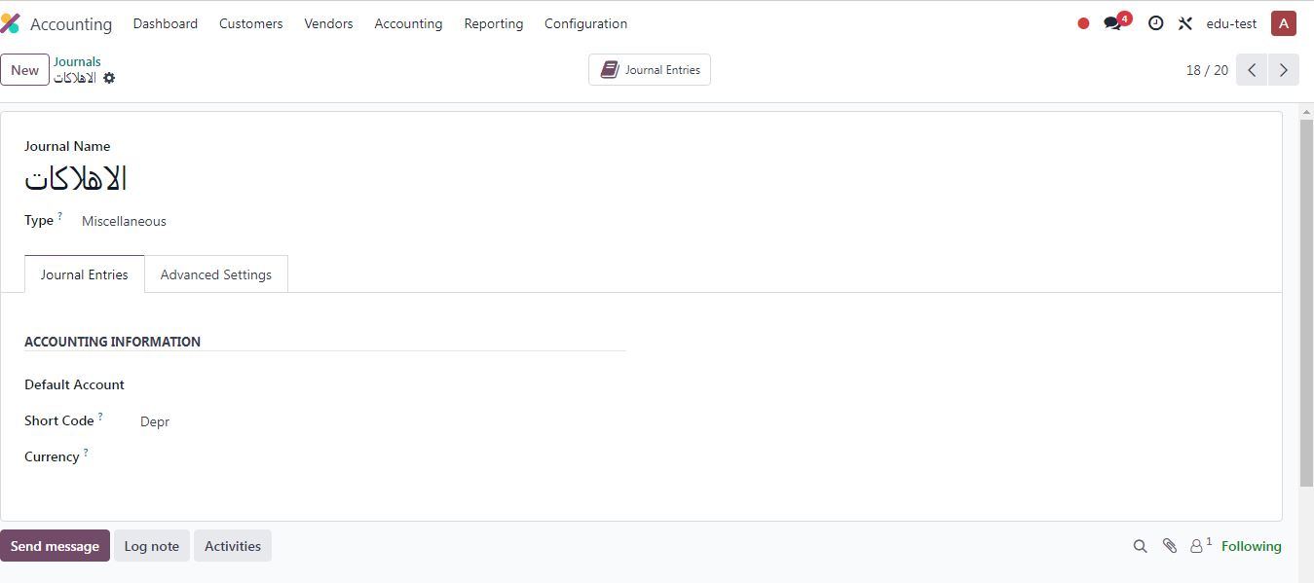
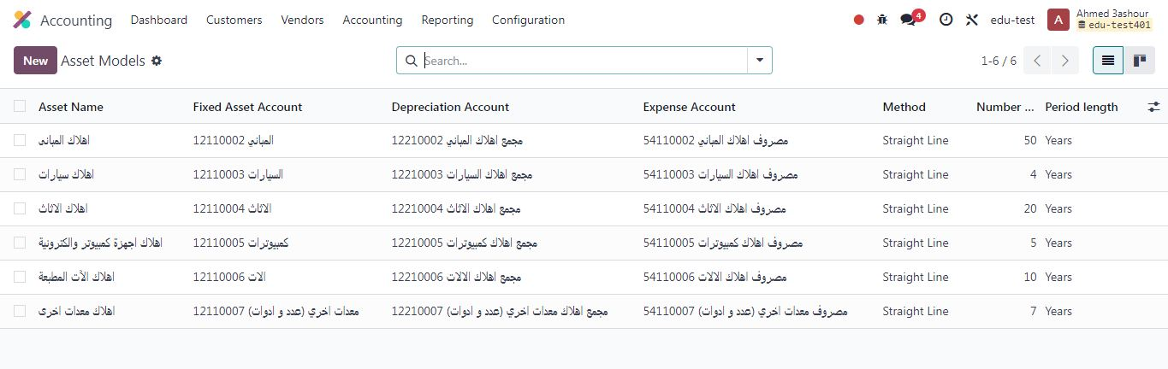
4- A special depreciation journal was created (short name: Depr):
5- Asset models were created for each account separately based on its depreciation rate, linked to asset accounts, accumulated depreciation accounts, and expense accounts:

Slide 22
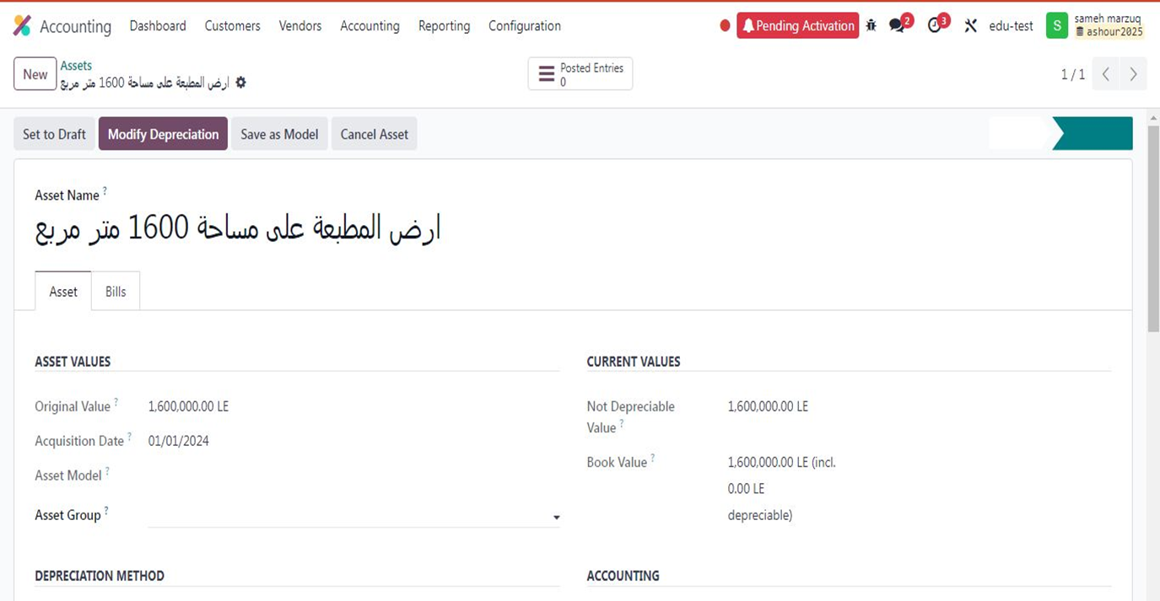
6- The value of the printing press land asset was entered, which is a non-depreciable asset, and linked to the relevant accounts in the chart of accounts:

Slide 23
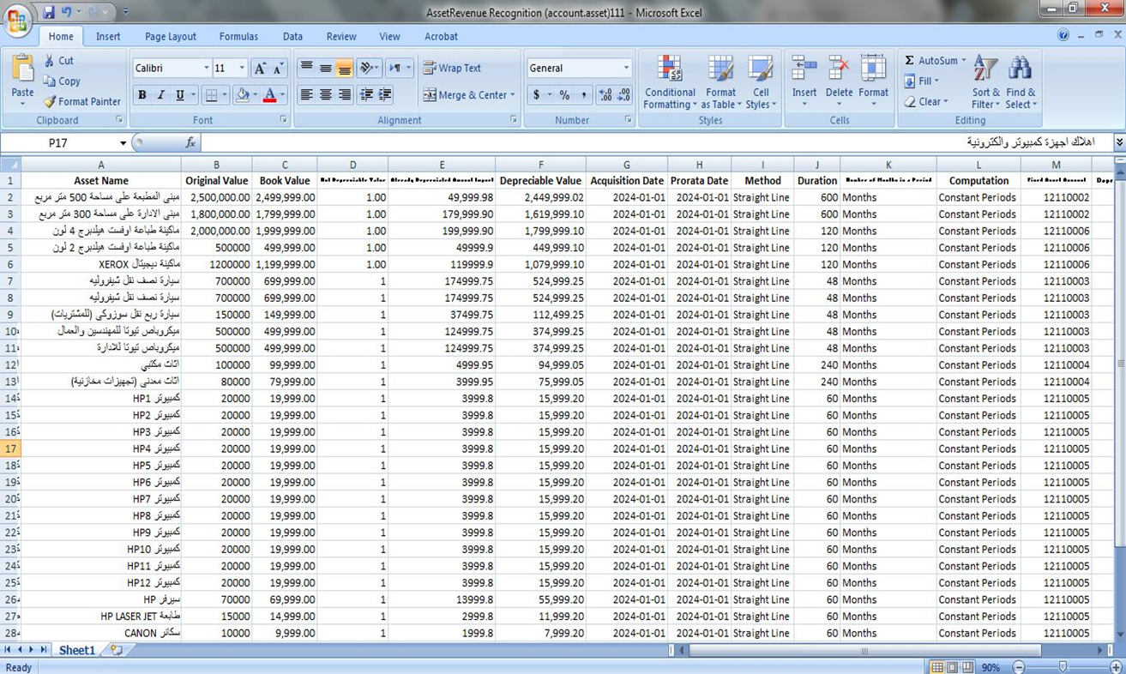
7- The basic data for the printing press assets were entered, including nominal value, depreciable value, depreciation rate, and depreciation method, and linked to the previously created Asset Models:

Slide 24
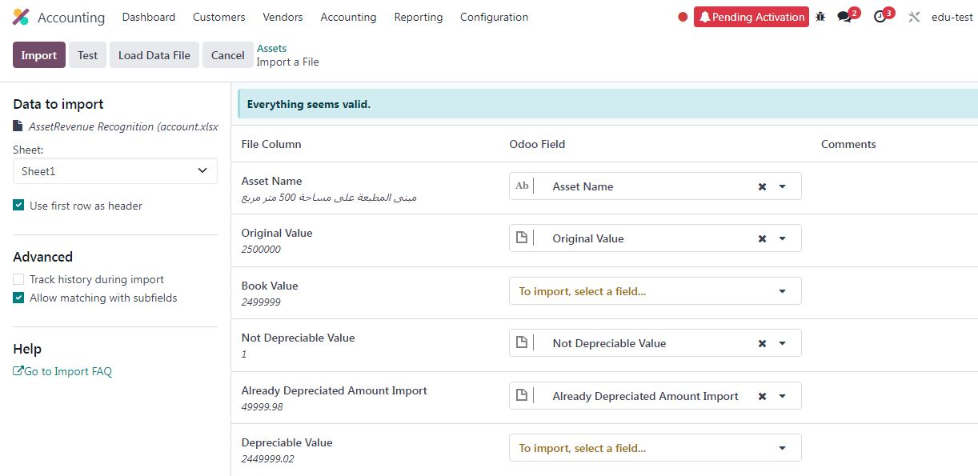
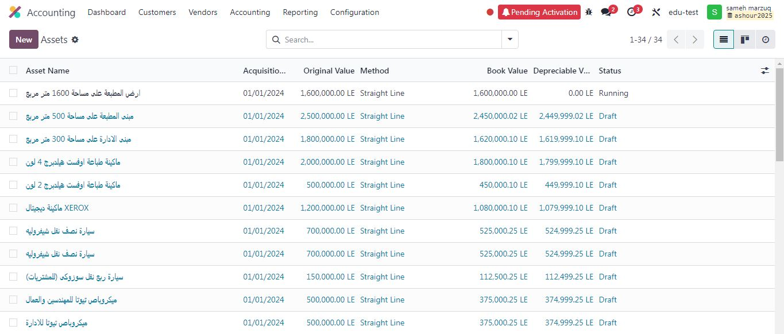

Slide 25
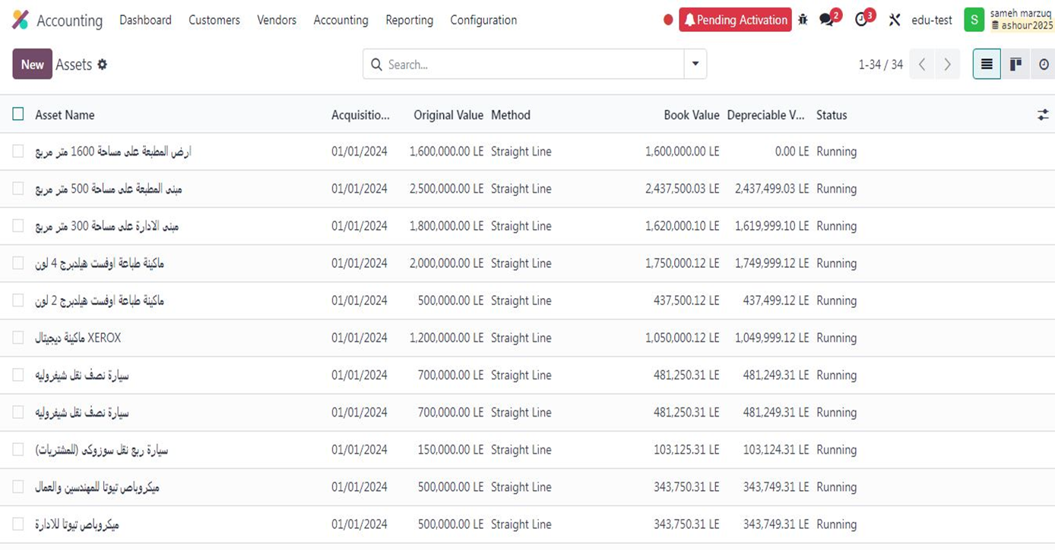
8- Asset depreciation was activated:

Slide 26
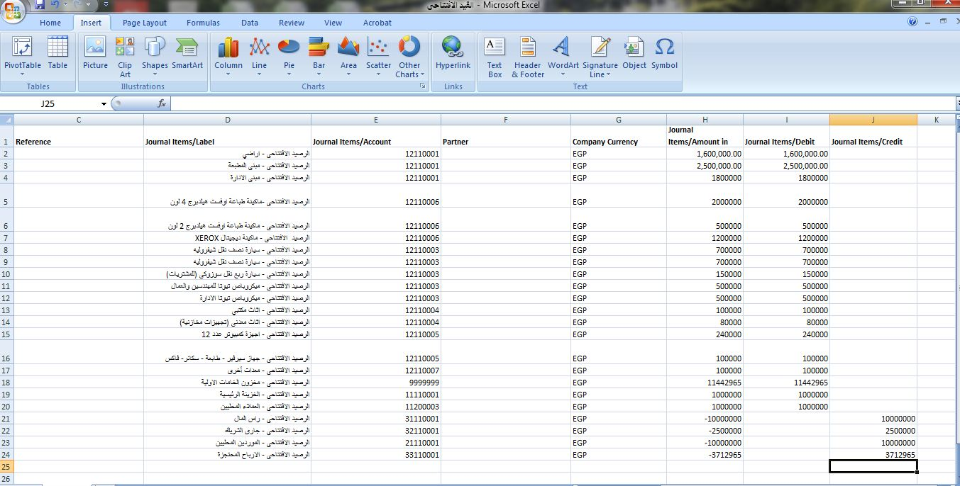
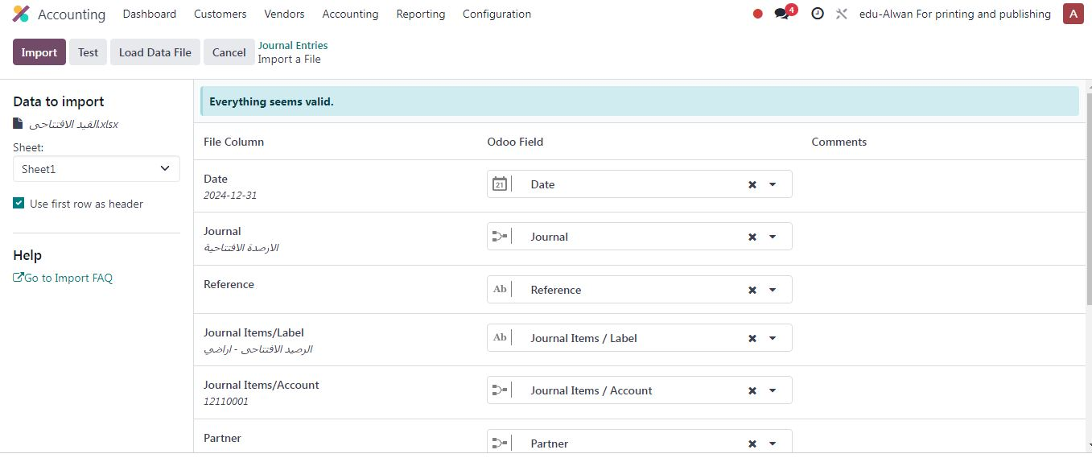
9- Creation of the opening journal entry for assets and general accounts:

Slide 27
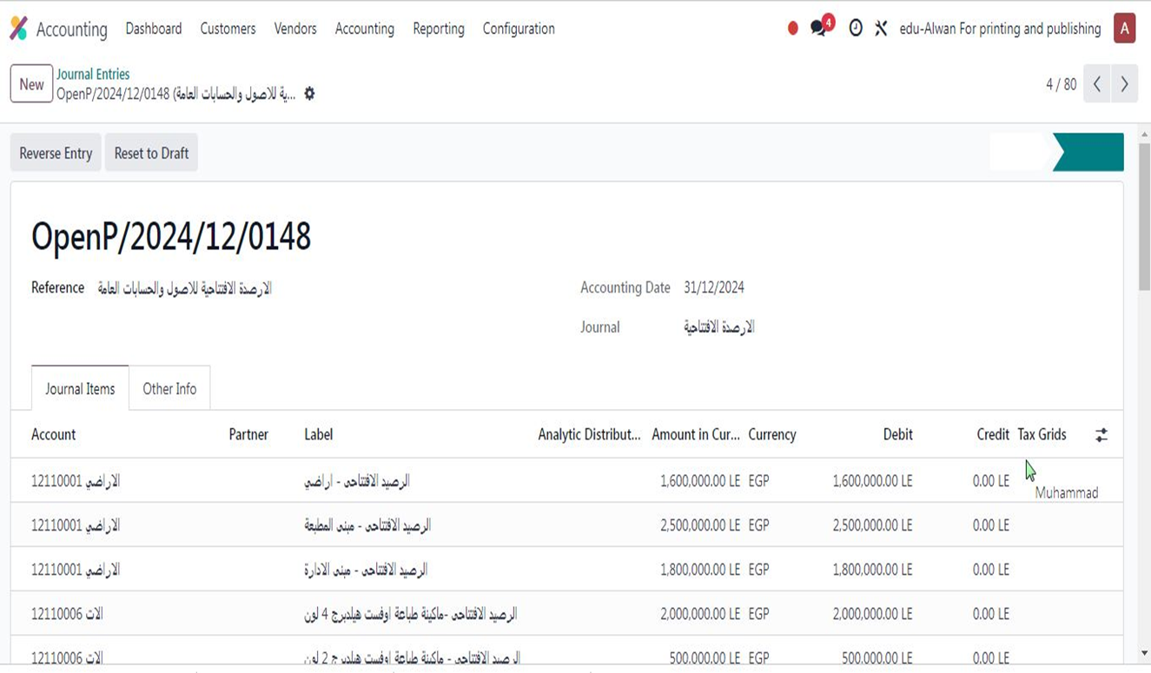

Slide 28
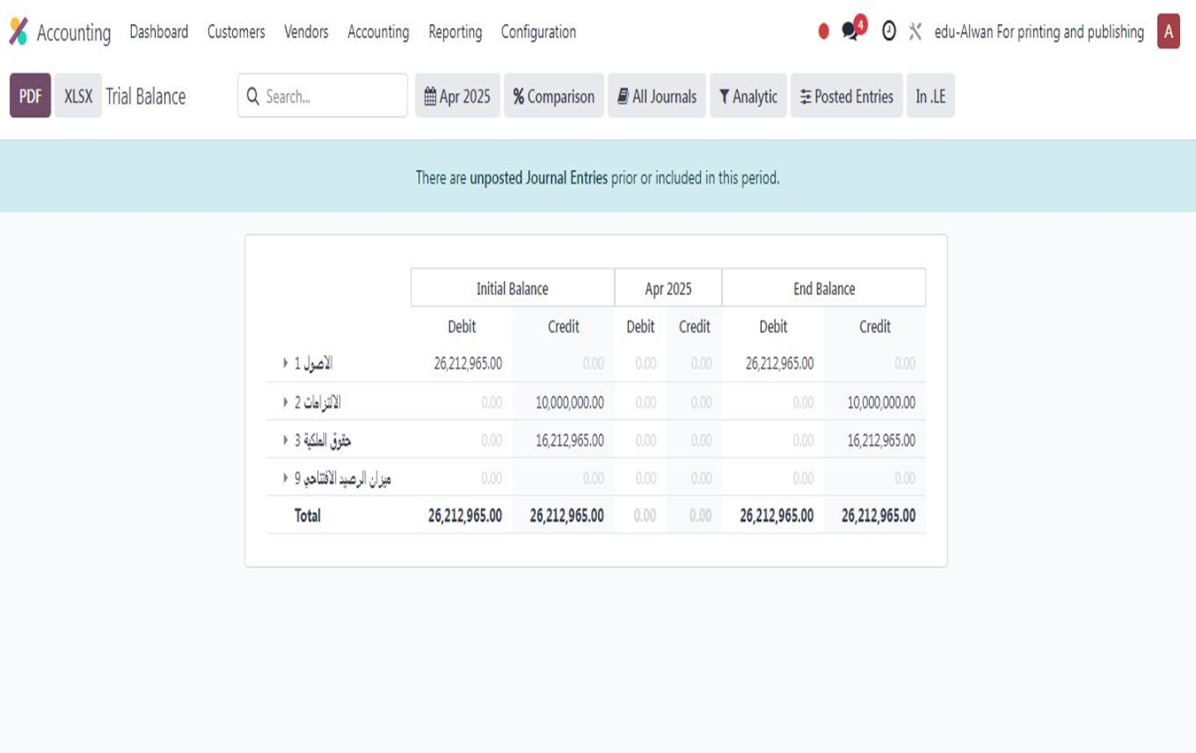
10- Balance of the trial balance after the first period upload:

Slide 29
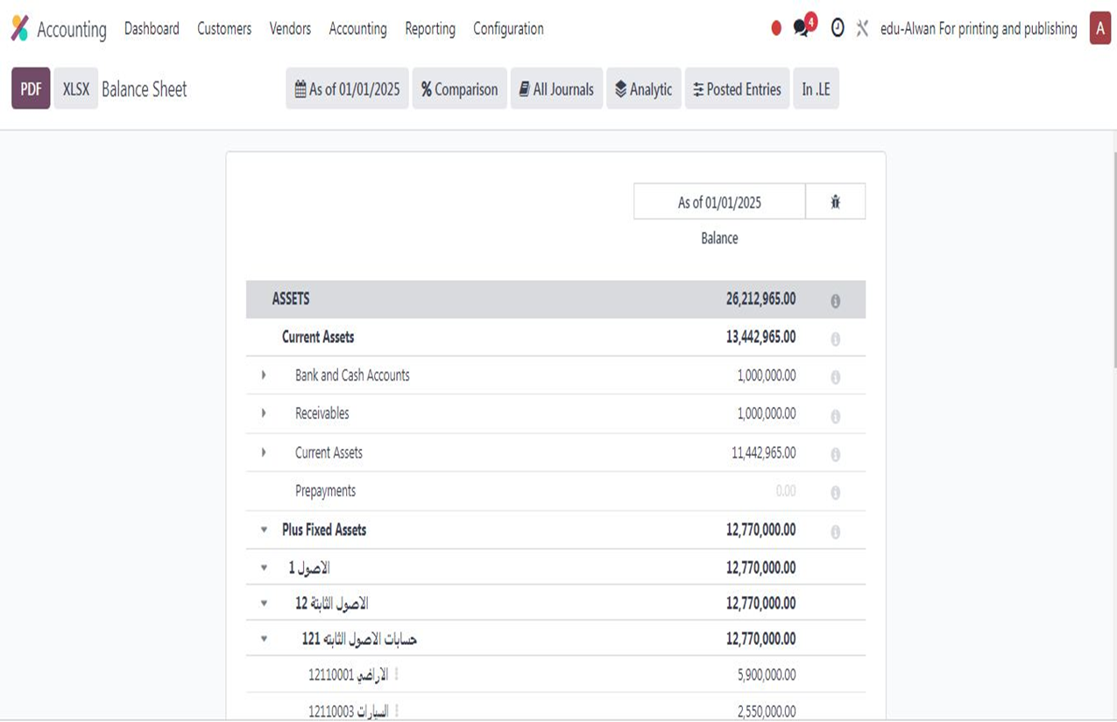
11- Opening balance of the balance sheet:

Slide 30
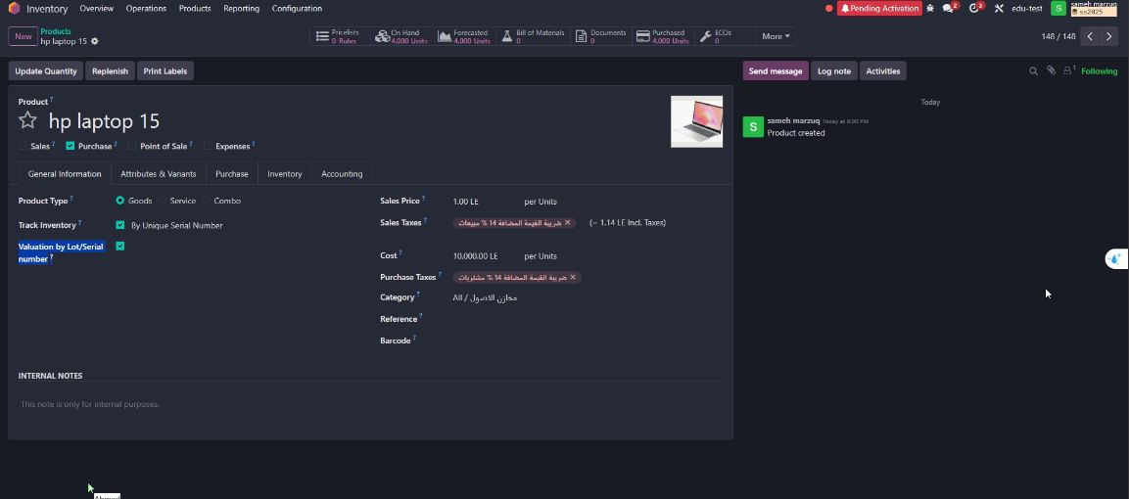
12- Client requested to retain fixed assets (computers, POS devices) via Purchase, with the following:
Asset purchase appears in the Accounting application’s Assets screen.
Track asset by Serial number.
Monitor cost via Valuation by Lot/Serial number.
The following workflow was created:

Slide 31
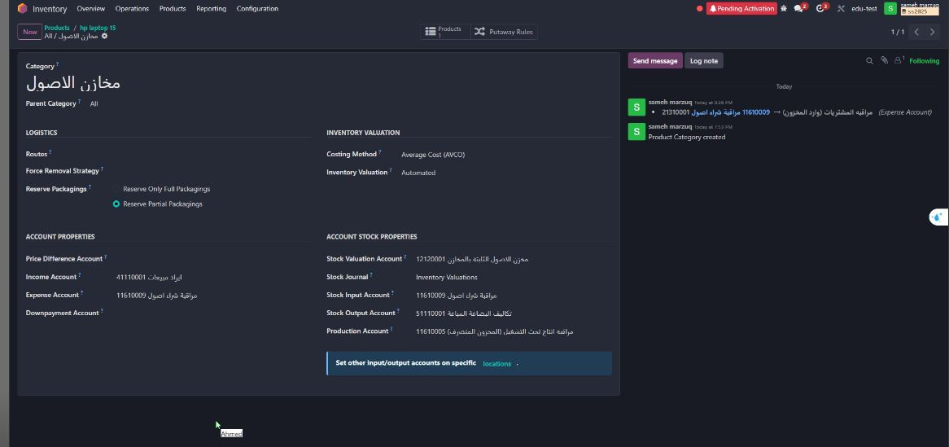
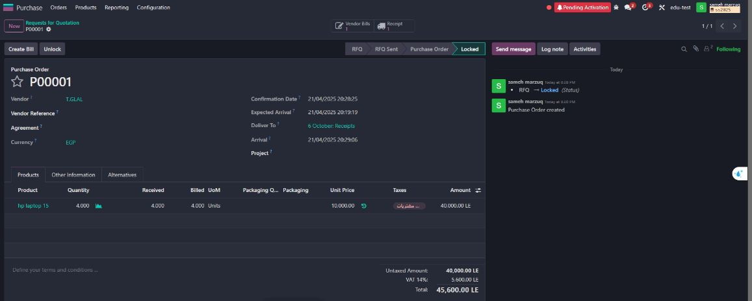

Slide 32
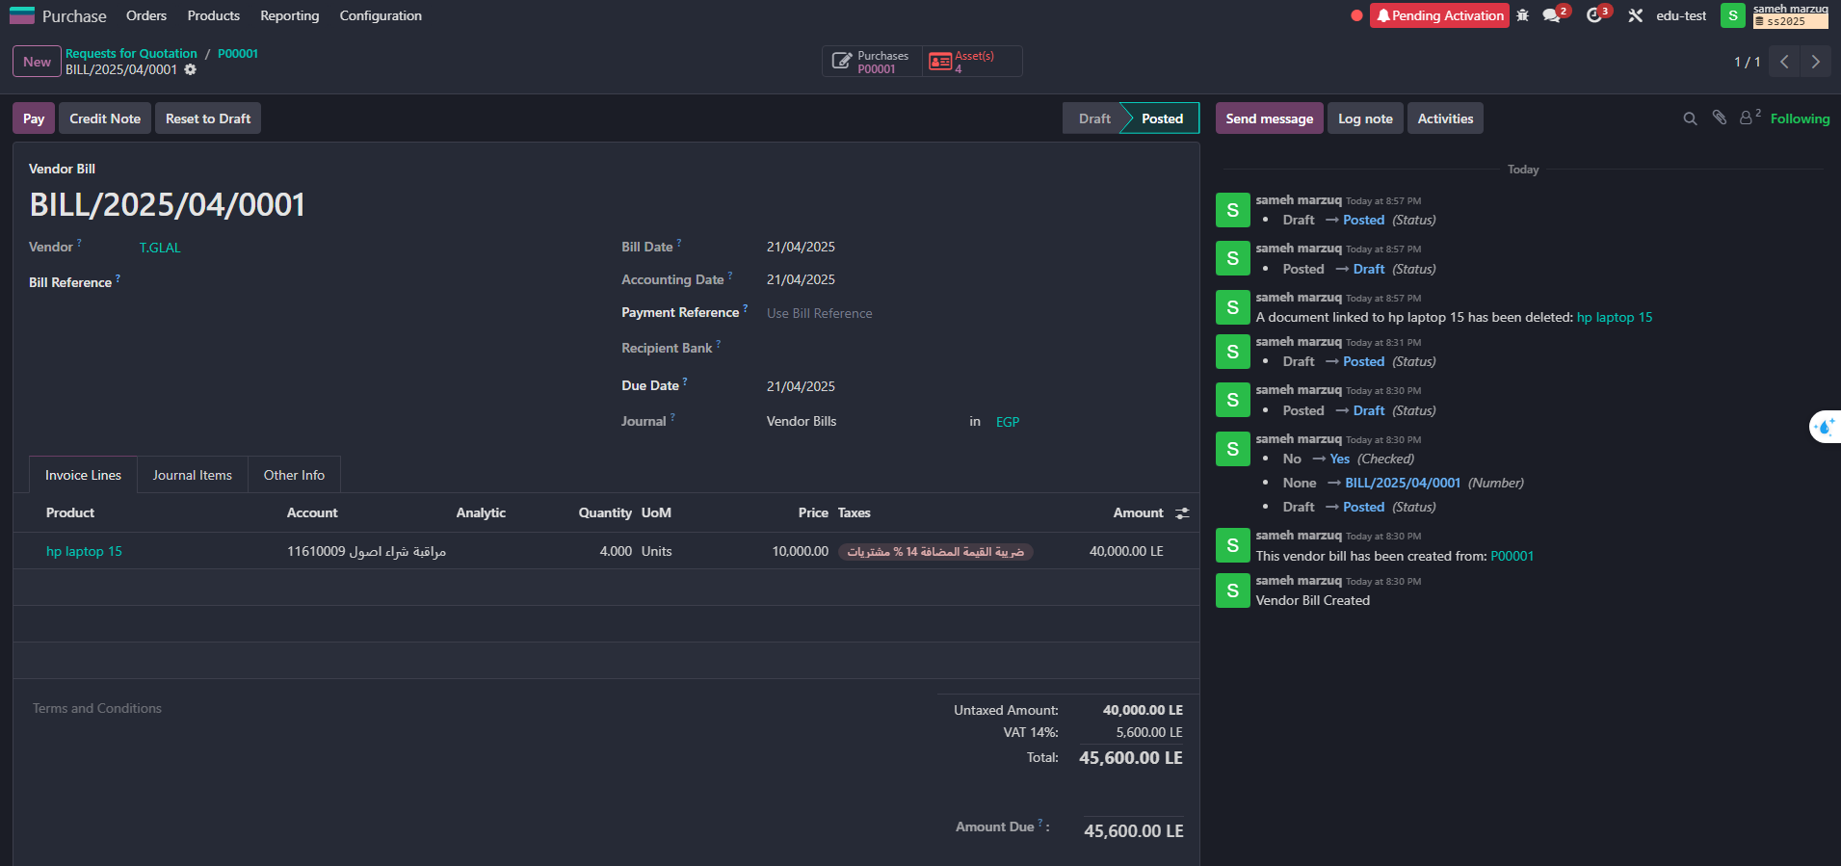
- The Assets mark appears automatically once the supplier invoice is created.

Slide 33
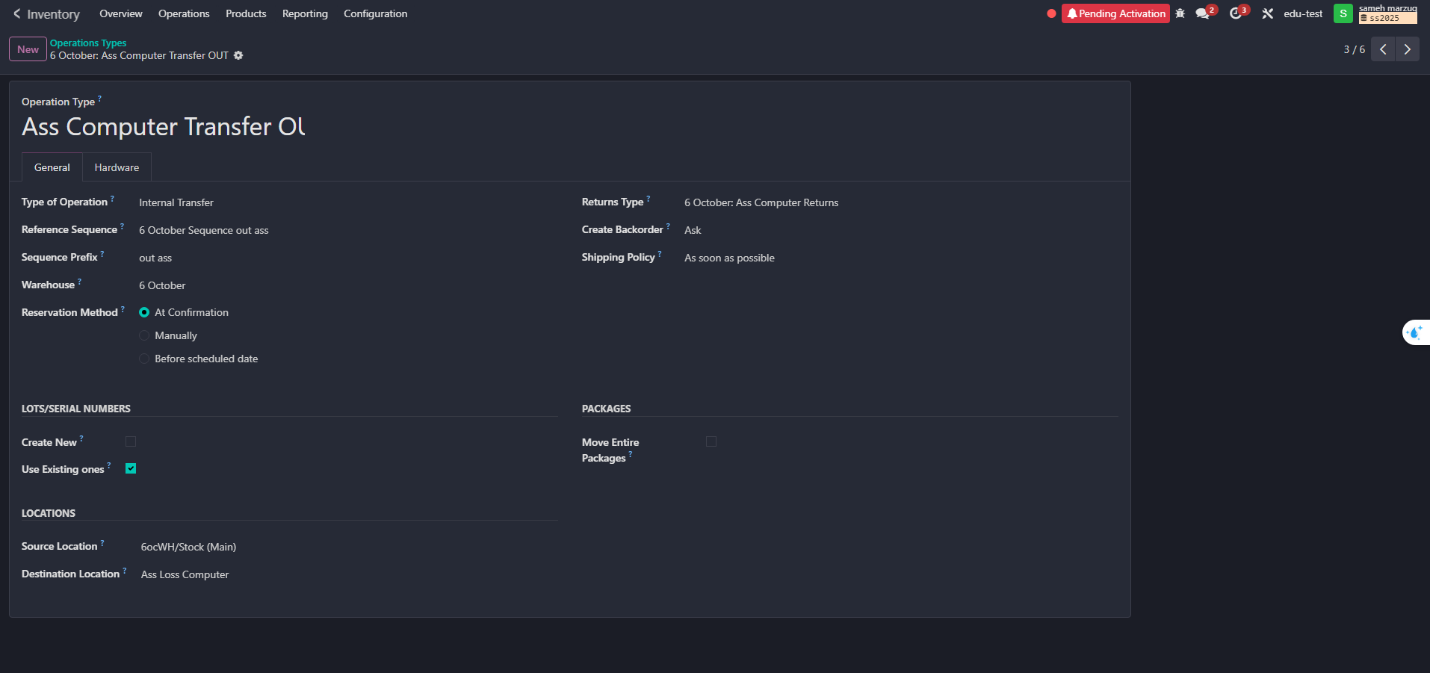
To complete the above workflow, two operation types were created in the Inventory system to organize asset movement:
1- Asst Computer Out – When assets are issued from the warehouse.
2- Asst Computer Return – When assets are returned to the warehouse.

Slide 34
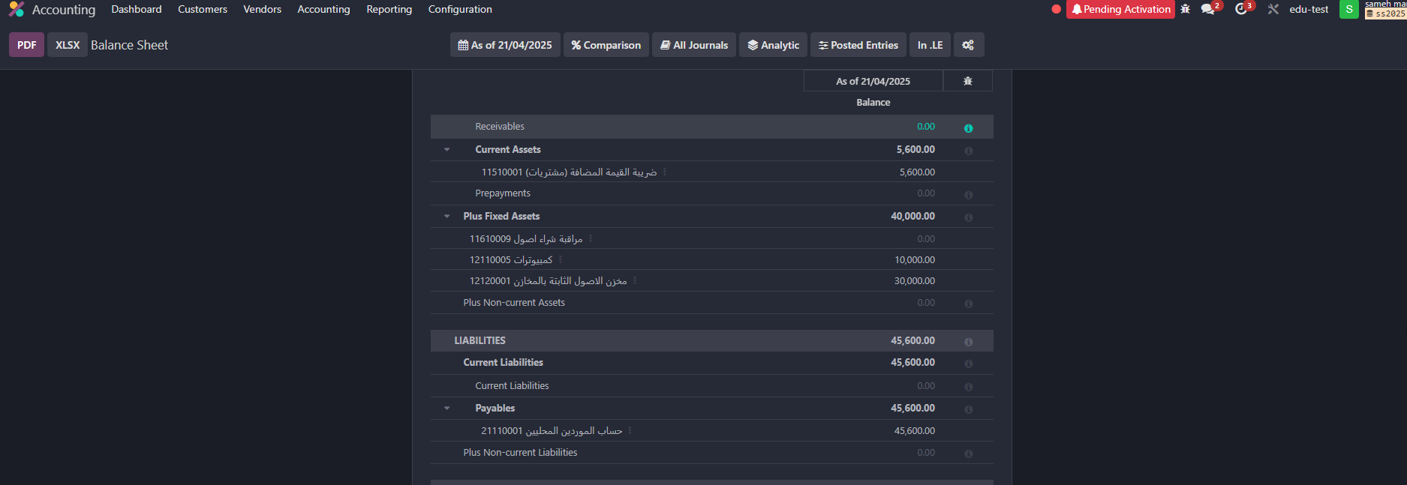
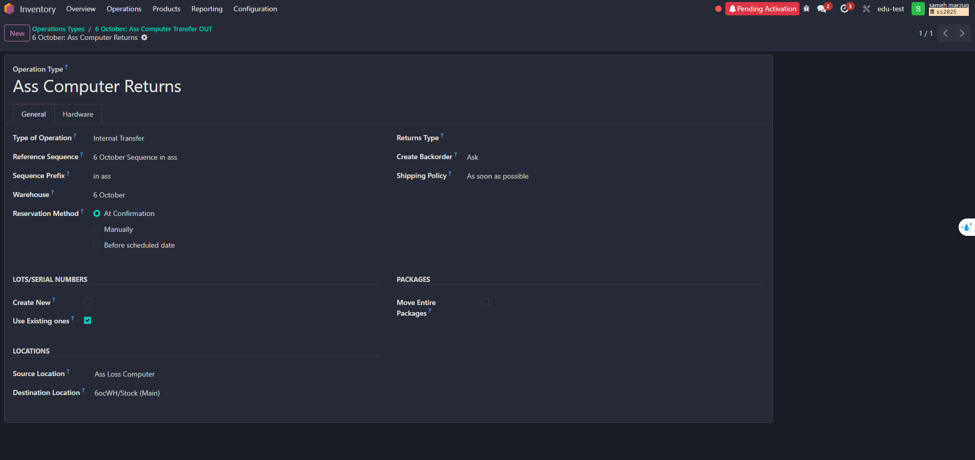

Slide 35
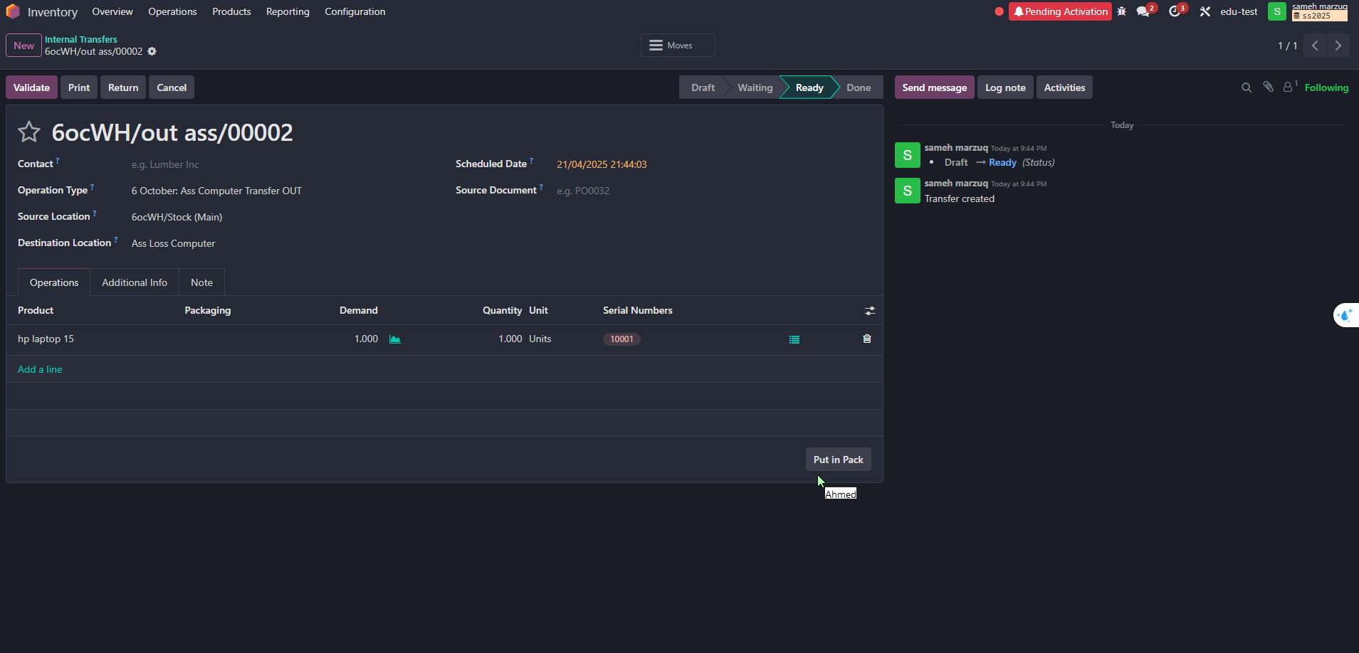
The accountant activates and starts depreciation for assets issued from the warehouse based on the warehouse release notes.

Slide 36
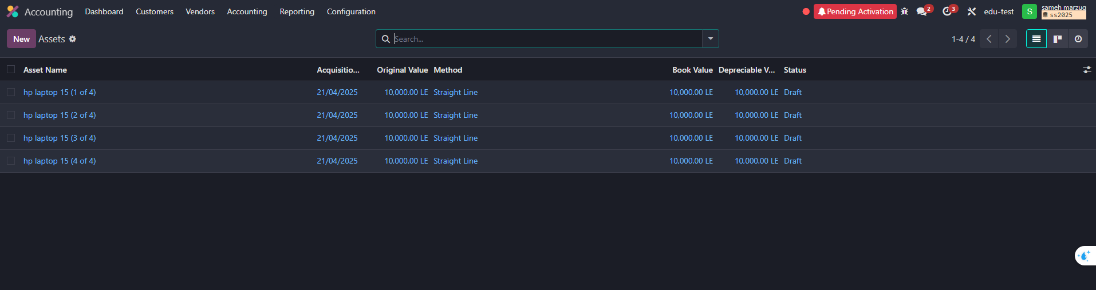
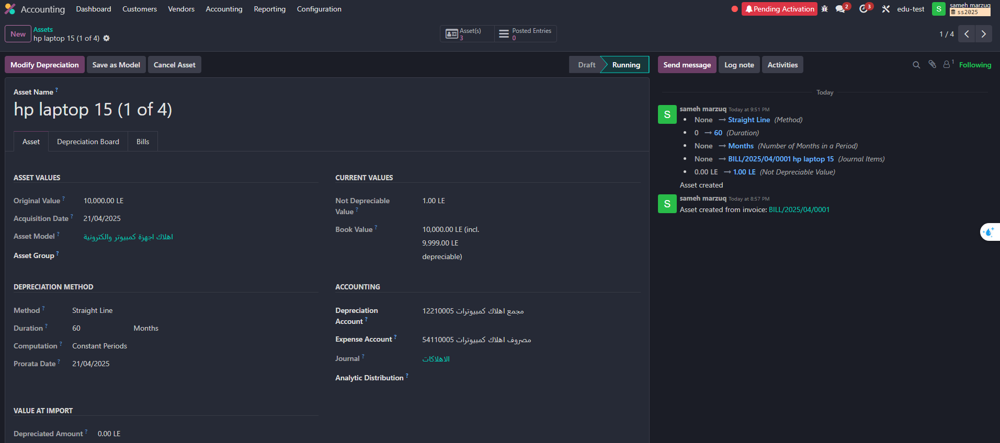

Slide 37
Inventory
It is an integrated ERP system that provides a powerful inventory management module that helps track materials and goods in real time.
The module is linked to purchasing, manufacturing, sales, and accounting modules, creating an integrated workflow.
It is based on the principle of "fully automated control of material flow."

Slide 38
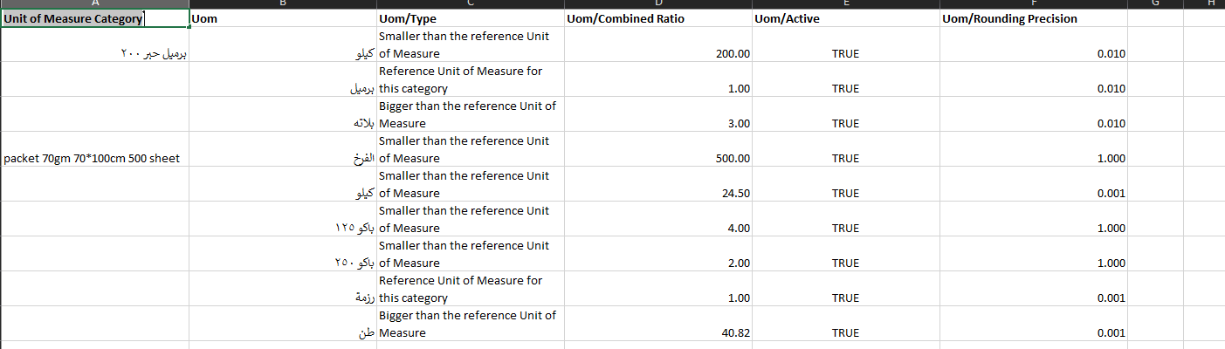
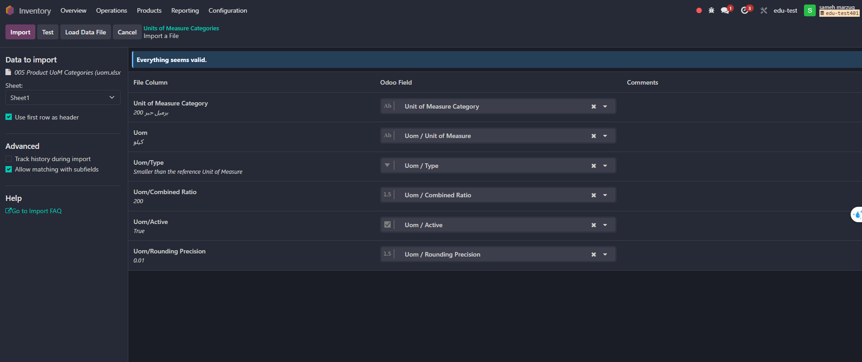
- Upload the Unit of Measure Category

Slide 39
The system will automate purchasing and disbursement using precise unit of measure (UOM) settings.
Quantities will be entered by weight, with the package defined as sub-units linked to fixed weights or sheet counts.
Automatic conversion between weight and packages will occur during disbursement based on approved settings.
This automation will reduce manual conversion errors and ensure warehouse balance accuracy.
A new UOM has been added to receive paper by ton and convert it into 500, 250, or 125-sheets packages.

Slide 40
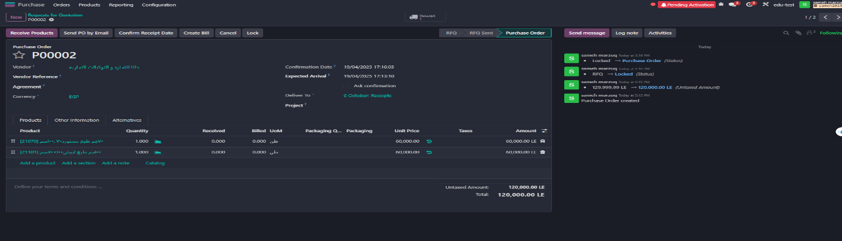
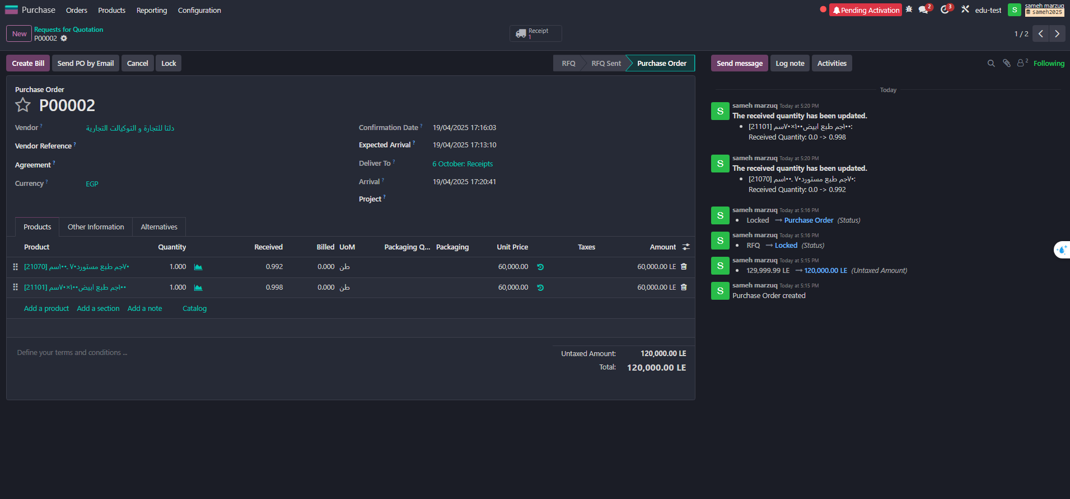

Slide 41
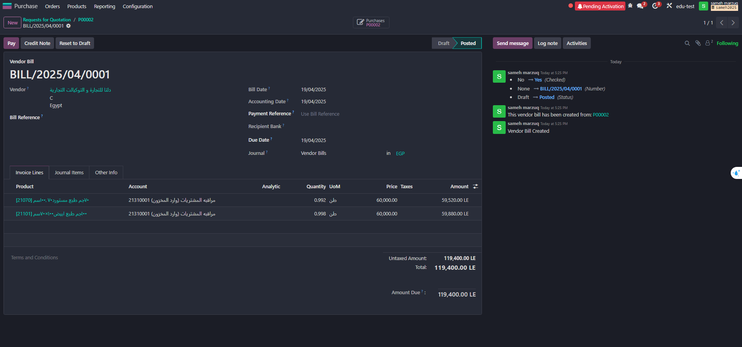

Slide 42
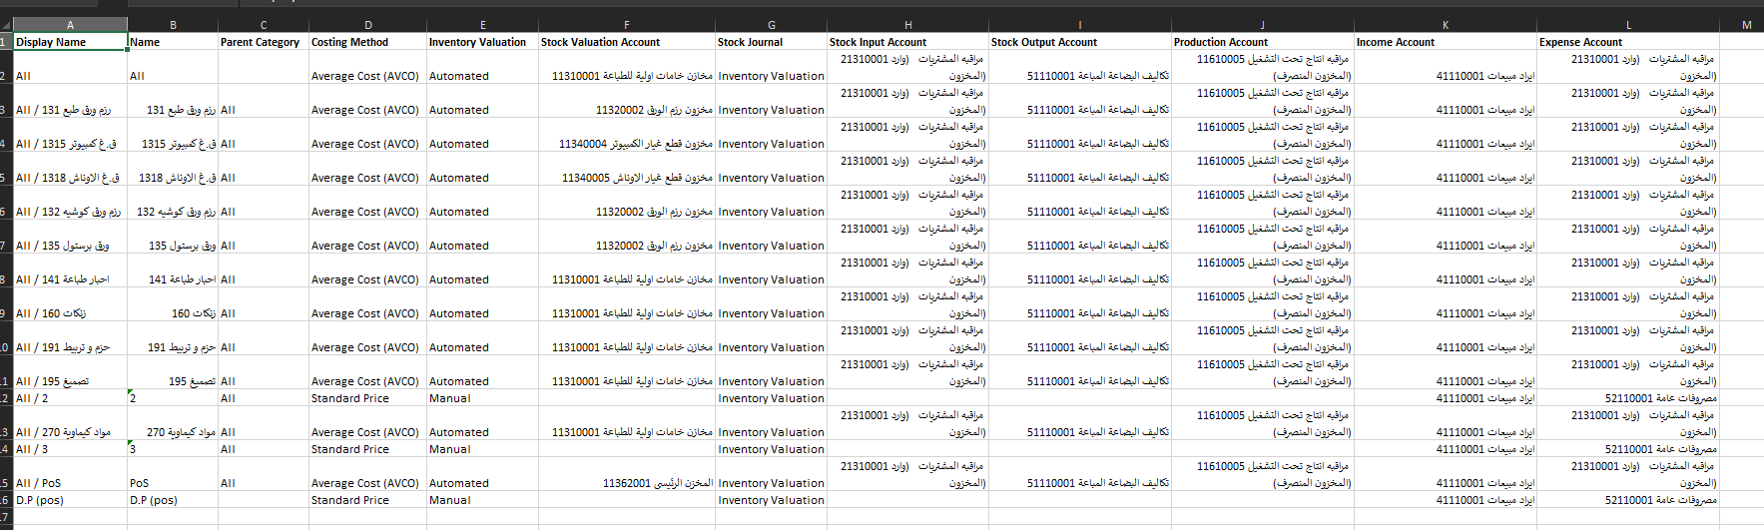
- Create Product Categories

Slide 43
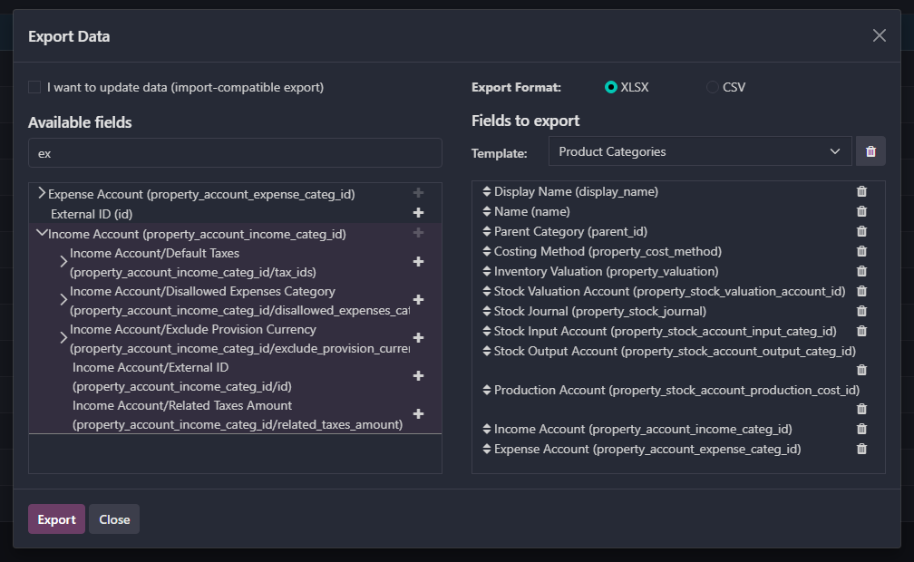

Slide 44
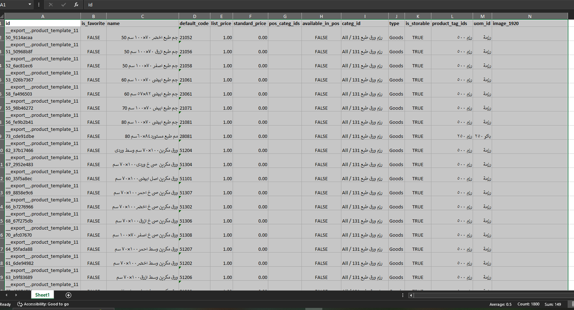
- Raise items according to Product Categories, specifying the Cost and Sales Price:

Slide 45
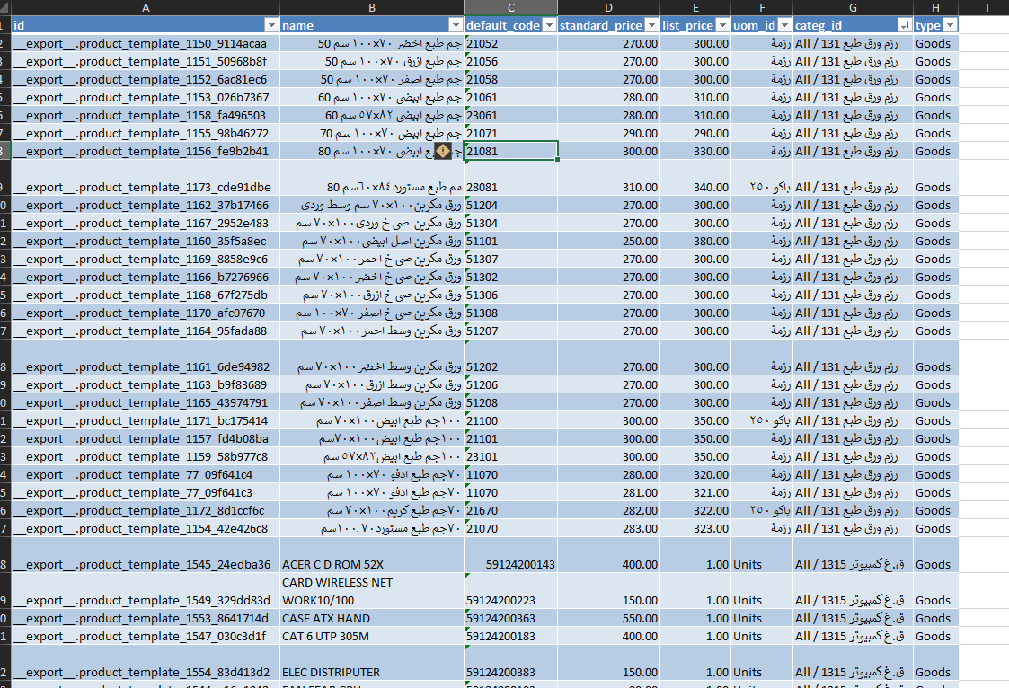


Slide 46

- Create Putaway Rules to link each Product Category to each specific location:

Slide 47

Upload The opening inventory balances

Slide 48



Slide 49



Slide 50


- Set order limit for items

Slide 51



Slide 52

Explaining the main inventory processes and some integrations between applications.
The receipt process appears with the relevant warehouse keeper when purchasing from the Purchasing app and confirming the purchase order.
When the order limit is reached, the product is replenished according to the routing in Replenishment.

Slide 53

- And ensure that the receiving process was done in the locations set in Putaways Rules to avoid receiving errors.

Slide 54


-Delivery also appears when linking the product to the MOT Route to provide the product on demand. After activating it from the Route, the link is done through the product screen.

Slide 55

- To then appear on the product screen

Slide 56

Internal transfers between different inventory sectors.
These occur in transfers between different warehouses and their associated operations, such as providing products in warehouses where the product was unavailable, manufacturing operations, or point-of-sale operations, depending on each product and its uses. This process is performed manually or automatically, depending on the product's order limit settings.

Slide 57

- Lots / Serial Numbers are used for products that need to be tracked, whether they are products used in production processes, such as computers and machines as printing press assets, or final products, such as scientific books and school books, which have an edition number and copyright, and are set from within the product screen, with the challenge of tracking the cost or not.

Slide 58

- After acquiring the Lots / Serial Numbers feature, the quantities of these items can be inquired about in the Lots / Serial Numbers report in the Warehouses application.

Slide 59



Slide 60

-When inventory items are damaged, Scrap Orders are created from the Inventory app.
-The locations for the damaged items are set, and the expense account is prepared.
-This will either include the cost of the damaged item as an expense or create another location to be set as a warehouse for the damaged items.
-The damaged items are then sold from the inventory, and the revenue from the inventory is considered to reduce losses resulting from the damaged items.

Slide 61



Slide 62
Additional costs for products (Landed Costs) when purchasing an imported product.
The initial cost recorded for that product is usually an estimate, due to the presence of additional expenses that have not yet been accounted for.
These costs—such as shipping, unloading, customs, and transportation—are not immediately available and are collected later through invoices issued by the finance department.
After the full actual cost has been determined by the general accounting department, the cost accountant uses the Landed Costs feature to accurately allocate these additional costs to products, whether they are still in inventory or various stages of manufacturing, and even if they have been sold.
This is where the power of Odoo ERP shines through, with its ability to accurately track and upload actual product costs, enhancing the accuracy of cost reports and profitability.
Journals operate under the name Landed Costs to facilitate the process of tracking these costs.

Slide 63


Slide 64

- Activate the feature and link it to Journals.

Slide 65

- Add products of the Service type and set them in the Purushas tab as the Landed cost product, then set the cost distribution method to Default Split Method, then Control Policy to On ordered quantities, and set the broker account used at the level of the Service product type.

Slide 66

- An example of a complete work cycle for Landed Costs: going and purchasing an imported product, receiving it in the warehouses, and then proving the supplier’s entitlement.

Slide 67



Slide 68


- Cost of the item in inventory.
- Add estimated costs until import invoices arrive.

Slide 69


-We notice a difference in the average cost after the estimated increase.
-Assuming that Al-Shorouk Printing Press requested to purchase imported inks and the printing press has an alternative, and the ink was distributed to the customer.

Slide 70



Slide 71


-The General Accounts issued import invoices and they were approved after a period of time from the sale or manufacturing process.

Slide 72



Slide 73



Slide 74

Purchases
The Purchases app in Odoo 18 helps companies manage supplier purchases efficiently, from creating purchase requests to receiving and paying bills.
🔹 Main Features of the Purchase App:
Manage purchase requests (Request for Quotation - RFQ)
-Register a new vendor.

Slide 75

Upload vendor data
Import vendor details from Excel

Slide 76

-Vendor screen after uploading the data

Slide 77


Easily create, edit, and track purchase orders
Create a Request for Quotation (RFQ)
Fill in the details of the Request for Quotation (RFQ)

Slide 78


Send an email to the vendor requesting a quotation (RFQ)
Print the Request for Quotation (RFQ)

Slide 79

- Approve the quotation and convert it into a Purchase Order (PO)

Slide 80

-When the Purchase Order (PO) is confirmed, a stock movement is created automatically.

Slide 81

Integration with the Inventory module
When the Purchase Order (PO) is confirmed, a stock movement is automatically created

Slide 82

Track the status of product receipt (Received, Partially Received)
According to the printing business process, products are fully received first, then the vendor bill is created based on the received quantities (Bill Control: Received Quantities)

Slide 83

The purchase accountant creates and validates the vendor bill after receiving the products

Slide 84


-Vendor Bills Management: Record vendor bills and link them to purchase orders by the general accountant.

Slide 85


Match vendor bills with purchase orders and received products (3-way matching)

Slide 86


Supplier Management
-Store supplier data and evaluate their performance (on-time delivery rate)

Slide 87

Purchase Agreement Management and Payment Terms
There are two types of purchase agreements: the first is Blanket Order, and the second is Purchase Template.
- Blanket Order
In this method, a specific vendor is selected, and purchase order details

Slide 88

After the purchase contract is approved, it is placed on hold until it is converted into a Request for Quotation (RFQ)

Slide 89

“New Quotation” can be used to create a request for a specific quantity from the contract, then approve it to convert it into a Purchase Order

Slide 90

Approve the quotation to convert it into a Purchase Order

Slide 91

- Purchase Template
This method does not require selecting a vendor

Slide 92


Click on "New Quotation" to compare offers from different vendors and define the payment terms
-The first vendor:

Slide 93


-The second vendor:

Slide 94

The offers are compared, then click on "Confirm Order" from the desired quotation

Slide 95

Alternatives
-This feature compares one purchase offer with another purchase offer in the same location

Slide 96

-Configure the settings

Slide 97


-Product Category
-Units of Measure Categories

Slide 98

-Vendor Pricelist

Slide 99


Reports and Analytics.
Reports on purchases, vendors, and purchasing performance.
Cost analysis and comparison of quotations.

Slide 100

Integration with other applications.
Accounting: Recording expenses and payments
Sales: Automatically create purchase orders based on customer orders.
Manufacturing (MRP): Purchase raw materials needed for production.

Slide 101
Benefits of Using the Purchasing App in Odoo 18:
Automate processes and reduce manual errors.
Improve vendor relationships by tracking performance and compliance with terms.
Financial control through matching invoices with purchase orders.
A comprehensive view of the supply chain from order to payment.

Slide 102
Sales
Introduction to the Sales App in Odoo:
The Sales app in Odoo is a powerful tool for managing the entire sales process, from quotations to invoices. It offers an easy-to-use interface and a set of features designed to streamline the sales process and enhance efficiency.

Slide 103

- Create professional quotations easily: Fill in quotation details with accuracy, quickly and easily, using complete customer information, product details, and the required quantity.

Slide 104
- Create professional quotations easily: Fill in quotation details with accuracy, quickly and easily, using complete customer information, product details, and the required quantity.

Slide 105

Display available stock quantities when selecting a product in the sales quotation.

Slide 106

Convert quotations into sales orders directly once the customer approves the prices.

Slide 107

Specify the warehouse responsible for delivering the sold items.

Slide 108

Green or Red Indicator:
The green indicator appears next to the requested quantity to show it is available and the expected quantity increase based on ongoing purchase orders.
The red indicator appears next to the requested quantity to show it is unavailable and the expected quantity increase based on ongoing purchase orders.
Note: To find the warehouse name, click on "View Forecast."

Slide 109


Create an Invoice
Create an Invoice

Slide 110


Invoice Payment
Customizable Templates (Quotation Templates)

Slide 111


View all sales orders in one dashboard.
Track the status of each order (Confirmed, Executed, etc.).

Slide 112


Manage payment terms and delivery methods.
Send an email to the customer with the selling price.

Slide 113


Print the sales order.
Complete customer record and purchase history.

Slide 114


Classify customers by sector or region.
Manage customer communications and interactions.

Slide 115


Price list
Customer statement of account.

Slide 116


Detailed sales reports.
Analyze sales team performance, with the ability to create sales teams and assign a manager to each region.

Slide 117


Performance Analysis
Ability to set sales targets for both the sales team and individual salespersons, with defined commissions through a Commission Plan.

Slide 118


Sales targets can be set annually, monthly, quarterly, or semi-annually based on company policy
Define the commission basis (e.g., invoice amount, sales amount, quantity on invoice, or quantity sold).
Specify the products eligible for commission and their related category.
Multiple salespersons can be added to contribute to the commission plan.

Slide 119

Sales and commission plans are created and approved by the Sales Manager. The system calculates commissions automatically upon approval.
Integration with Other Apps:
Integration with Inventory for product management.
Integration with Accounting for invoices and payments.
Integration with CRM for customer relationship management.

Slide 120
Accounting Module
The Accounting Module in Odoo is a cornerstone for managing the financial affairs of any company, including medium-sized printing houses. It provides an integrated and flexible system for tracking and recording all financial transactions, generating important reports, and making informed decisions to improve financial performance.

Slide 121

Accounting Module Settings
The settings for the Accounting Module have been configured, and the default accounts have been defined:

Slide 122

🔹 Key Features of the Accounting Module in Odoo
Customer Invoice Management
This feature allows you to efficiently create and manage customer invoices.
You can customize and design invoices, send them directly via email, and track the payment status of each invoice.
The system automatically reminds you of overdue invoices, ensuring timely collection of your dues.
This significantly contributes to improving your company's cash flow management.
To access customer invoices, navigate as shown in the following image:

Slide 123

Once you open customer invoices, you will see invoices in all their statuses:

Slide 124

The "Status" column displays the invoice statuses: Draft, Cancelled, and Done.
The "Payment Status" column shows the payment status: Paid, Not Paid, and Partially Paid. Clicking on an invoice displays its details.
For example, if you click on an invoice with a "Draft" status:

Slide 125

This highlights the integration between the Sales and Accounting Module.
Once a quotation is approved by the sales team, they can create an invoice.
Then, the Accounting Module is used to review, approve, and confirm the invoice.
You can also set the invoice date, due date, payment terms, and any specific notes before approval.

Slide 126

After confirming the invoice by clicking "Confirm," the approved and posted accounting entries, the invoice number, and other options will be displayed.
If you click on "Print & Send":

Slide 127

You can print the invoice. If you click "Continue":
You will have the option to send the invoice via email.

Slide 128

If you click on "Credit Note":

Slide 129

You can issue a credit note for the customer invoice by selecting "Reverse.“
You can choose to reverse part or all of the invoice.
The "Reverse and Create Credit Note" option is used if you need to modify the invoice after it has been approved and submitted to the electronic system.
If you select "Reverse":

Slide 130


The system generates the credit note for the invoice. Clicking "Confirm" will change the status of the credit note to "Paid" as it is settled against the sales invoice.
Returning to the sales invoice
You will see that the invoice has been settled with the credit note.

Slide 131

Now, let's look at payment options. Odoo offers two ways to pay invoices: directly and indirectly.
For the direct method, go to the invoice you want to pay and click "Pay":

Slide 132

You can specify the bank or cash account used for the payment, along with the date and amount.
You can pay the full invoice amount or a partial payment.
If you specify a partial payment:

Slide 133

You have two options: "Keep Open" to leave the remaining amount pending or "Mark as fully paid" to settle the invoice and specify a contra account for the unpaid balance.

Slide 134

After making a partial payment and selecting "Keep Open," the invoice status will be "Partial," and the remaining amount due will be displayed at the bottom of the screen. This amount can be paid later using the same method.
Alternatively, you can use the indirect method to pay the remaining amount. Go to "Payment" under "Customers" and click "New":

Slide 135

Here, you can record a customer payment by specifying the customer, amount, payment account or cash register, and date.
You can also add a memo for the payment. After completing the information and clicking "Confirm," the entry will be posted. Returning to the invoice:

Slide 136

You will see "Outstanding Credits," which can be applied to the invoice by clicking "Add":
The invoice status will then change to "Paid," and the payments made will be displayed at the bottom of the screen.

Slide 137

Down Payments
Odoo also supports customer down payments, which start from the Sales module:

Slide 138

Before delivering the product, instead of choosing "Regular invoice," you can select "Down payment (percentage)" or "Down payment (fixed amount)," specify the amount, and click "Create Draft":

Slide 139

The system will create the invoice (down payment receipt), which you can confirm and pay as described earlier, and print for the customer:

Slide 140


The contra account for the customer account is determined by the "Product Category" of the product:
After delivering the products and creating the final invoice for the customer:

Slide 141


The system displays the amount that was previously invoiced as a down payment. Creating the invoice:
The system displays the amount that was previously invoiced as a down payment. Creating the invoice:
The system displays the amount that was previously invoiced as a down payment. Creating the invoice.

Slide 142

The remaining amount can be paid through the invoice payment option:

Slide 143

After payment, it will appear in the customer's account at the "Partner Ledger":

Slide 144

Searching by the customer's name:
Displays the customer's account statement with all transactions and their dates, showing the transaction type. It also indicates if the customer is also a vendor, displaying their invoices and payments.

Slide 145

Vendor Bill Management
You can manage and record vendor bills in the system, track due dates, record payments, and maintain an accurate record of all your financial obligations to vendors. This feature helps you organize your payments and avoid late payment penalties.
To access vendor bills, navigate as shown in the following image:

Slide 146

Once you open vendor bills, you will see purchase orders that need to be billed, approved bills, and cancelled bills:

Slide 147

The "Status" column displays the bill statuses: Draft, Cancelled, and Done.
The "Payment Status" column shows the payment status: Paid, Not Paid, and Partially Paid.
Clicking on a bill displays its details. For example, if you click on a bill with a "Draft" status:

Slide 148

This shows the integration between the Purchase, Inventory, and Accounting Modules.
Once the products are received by the warehouse team, the purchasing team can create a bill.
The Accounting Module is then used to review, approve, and confirm the bill. You can also set the bill date, due date, payment terms, and add any specific notes before approval.

Slide 149

After confirming the bill by clicking "Confirm," the approved and posted accounting entries will be displayed.
The "Reset to Draft" option is available for all invoices, whether sales or purchase invoices.
It reverses the bill's confirmation and the related entries, returning the bill to the "Draft" status. This is used to modify bill data or cancel the bill.
If you click on "Credit Note":

Slide 150

You can issue a credit note for the bill by selecting "Reverse.“
You can choose to reverse part or all of the bill.
The "Reverse and Create Credit Note" option is used if you need to modify the bill after it has been approved and submitted to the electronic system, similar to sales invoices.
You can view bills for which credit notes have been created by going to:

Slide 151

The bills and their statuses will be displayed:
You can also efficiently manage vendor accounts:

Slide 152

Searching for the vendor's name:
Displays the vendor's account statement with all transactions and their dates, showing the transaction type.
It shows bills, payments, and returns.

Slide 153

Expense and Revenue Management
Odoo handles revenue and expense processing similarly to business transactions by creating a "Product Category" for each group of similar revenues and expenses.
First, you need to create the product:

Slide 154

The expense is defined as a "Service" product and linked to a "Product Category" for expenses.
It is also linked to a fixed expense account.

Slide 155


Then, you can create the expense through "Bills" by selecting "New":
Specify the vendor, product, and amount:

Slide 156

Then, confirm and pay the bill:

Slide 157


Similarly, for revenues, start by creating the product:
Define it as a "Sales" product with the type "Service" and link it to a "Product Category" for revenues.
Link it to a fixed revenue account.
Then, you can create the revenue through "Invoice" by selecting "New" and following the same steps as for expenses.

Slide 158

Financial Transaction Management
Odoo allows you to create journal entries for all accounts, which are typically used for adjustments and adding balances.
This is done through "Journal Entries":

Slide 159

This feature enables you to make any necessary entries for the accounts, such as transferring funds from the bank to the cash register:

Slide 160

This feature enables you to make any necessary entries for the accounts, such as transferring funds from the bank to the cash register:

Slide 161

Dashboard
In today's fast-paced and ever-changing business environment, especially in the printing sector, which requires precise management of costs and deadlines, having a clear and immediate view of the company's performance is crucial.
This is where the Odoo Dashboard comes in, acting as a command center that provides a comprehensive and customizable overview of your business's most important Key Performance Indicators (KPIs).
The Dashboard serves as a report and summary of required and completed tasks. As shown here, the Dashboard displays the number of invoices that need confirmation, unpaid and overdue invoices, and the balances and pending transactions for the cash register and bank accounts.

Slide 162

Financial Statements
At the heart of any successful business, particularly in the printing sector with its fluctuating profit margins and potential production costs, lies the ability to accurately understand and analyse financial performance.
The Odoo Accounting module offers a comprehensive suite of financial statements that go beyond simply recording transactions.
It provides deep insights to help you make informed strategic decisions and achieve sustainability and growth for your company.

Slide 163

Imagine being able to get an accurate snapshot of your company's assets, liabilities, and equity at any moment.
The Balance Sheet in Odoo provides this clear picture, helping you assess your company's financial strength and ability to meet its obligations.

Slide 164
You can precisely determine the profitability of your printing services through the Profit and Loss statement in Odoo.
It summarizes your revenues and expenses over a specific period, revealing your net profit or loss.
This vital information helps you identify the most profitable services, control costs, and make effective pricing decisions.
The Odoo Accounting Module also provides various financial reports that can be used to measure business performance.
The Odoo 18 Accounting module is not just accounting software; it's a strategic partner that helps your printing company achieve higher operational efficiency, reduce costs, improve cash flow, and make informed decisions that support sustainable growth.

Slide 165

Manufacturing
It was used to organize production operations.
Coordination was done with production and quality engineers to define raw material usage for each product based on customer orders.
Calculations were made in Excel, and the results were added to Odoo as Bills of Materials (BOMs) to ensure production accuracy

Slide 166

- Configuration Settings

Slide 167


- Warehouse setup and receipt/delivery methods

Slide 168


- Creating Product Categories for similar manufactured items
- Creating Locations for similar items

Slide 169

Creating Putaway Rules for storing finished products in their designated locations based on Product Categories

Slide 170


eating A4 notebook product with variations of 70/80g, wire/Regular, paper count 60/80/100/150/200, displaying the main reference using Odoo Studio

Slide 171

Uploading the Reference

Slide 172

Adding Search Product to display only manufactured products (Bills of Materials & Manufacturing Orders) for easier selection

Slide 173

Simple workflow
Manufacture a standard notebook with 60 sheets of 70g A4 paper.
Create a Bill of Materials (BOM) for the manufactured item
Boom Overview screen, showing the initial cost of the product before manufacturing, available raw materials, and how many units can be produced from the same product.

Slide 174

Boom Overview screen, showing the initial cost of the product before manufacturing, available raw materials, and how many units can be produced from the same product.

Slide 175


- Creating a Manufacturing Order (MO) with the option to adjust quantities

Slide 176



Slide 177



Slide 178


- Stock report in warehouses
Valuation report

Slide 179


Recording stock movement in journal entries (raw materials and finished goods)

Slide 180


Creating Work Centers and configuring their settings
Creating Operations

Slide 181


- Semi-finished products and by-products were created in preparation for their use in main manufacturing orders.

Slide 182

- Creating Locations for semi-finished products and by-products

Slide 183


- Creating a product category for each similar group of items

Slide 184


Configuring Putaway Rules
Configuring Bills of Materials for semi-finished products to use the same machine as the final product

Slide 185

Overview of BoM after configuring the previous settings

Slide 186


Starting the manufacturing process and creating a Manufacturing Order (MO)
Configuring Bills of Materials for semi-finished products to use the same machine as the final product

Slide 187

From the Work Centers Overview, we notice the change in colors of alternative machines in preparation for operating the printing and packaging machines, utilizing the "Alternative Work centers" feature in Work Centers.

Slide 188


Starting the Source MO and issuing raw materials from the warehouse while considering creating a Backorder

Slide 189


After clicking Plan Start and starting the manufacturing process, we notice the machine is reserved for the main manufacturing order

Slide 190

- Go directly to the Child MO to provide the cover when its stage is reached in the main manufacturing order and receive its raw materials from the warehouse

Slide 191

It was printed using the alternative machine because the main machine was busy with the main manufacturing order, and the semi-finished product was prepared in advance and received in the main manufacturing order.

Slide 192

Noting that the printing machines are working simultaneously on the same Source MO

Slide 193


- Then return to the Source MO and receive the semi-finished product from the warehouse
- After receiving and completing the production time and storing the final product in the warehouse, view the B.O.V

Slide 194

During the receipt process, the By-Product appears

Slide 195


BOM Overview

Slide 196
Point of Sale (POS)
Objective: Streamline sales processes in bookstores while automatically integrating them with the rest of the system (purchasing, inventory, accounting, sales, manufacturing).
Key Features:
o Quick sales without the need to manually create an invoice.
o Complex sales support (print adjustments during sales, adding additional services)

Slide 197


Point of Sale Settings
1- Determine the number of branches and create a point of sale for each branch, knowing that the customer has a showroom in 6th of October next to the printing press and a point of sale in Giza.
2- Adjust the settings of each point of sale

Slide 198


3- Setting payment methods at each point of sale (Payment Methods, Journal, and Accounts) and linking them to the points of sale.

Slide 199


Slide 200



4- Creating warehouses and warehouse operations for points of sale, including delivery, receipt, return, and depreciation, and controlling them at each point of sale (Pos).
Create POS Warehouse and Inventory Operation

Slide 201


5- Upload POS Product Categories and set up the POS interface

Slide 202

6-Adjust the settings for the products that appear at the points of sale with the application on the rest of the products.

Slide 203

7- Setting default journals at the branch level to tighten control.

Slide 204


8-Adjusting invoice numbering at each point of sale.

Slide 205


9-Define employees and the responsibilities of each employee on the POS and create a PIN code from the Employees application

Slide 206


10-Adjusting the currency in Cash and the method of displaying taxes in POS

Slide 207



11- Conduct a complete work cycle on the POS to implement the basic steps in the sales process, as shown in the pictures:

Slide 208




Slide 209



Slide 210

Note: The sale process was completed using three payment methods, and we will show, as shown in the following images, the extent of the system’s flexibility in dealing with them according to the settings that were made, whether from within the POS, Accounting, or Receivable application, and the extent of integration between the system’s applications.

Slide 211


Slide 212


12-Make refund

Slide 213



Slide 214


Slide 215
Conclusion
this project represents a practical step towards digitizing and efficiently managing printing operations using Odoo. Gaps were analyzed and custom solutions implemented to meet the client's needs. We hope this work serves as a valuable milestone in our professional journey.

